Slide 1
Module-4
Neural network learning

Slide 2
From biological to artificial neurons
Because ANNs were intentionally designed as conceptual models of human brain activity, it is helpful to first understand how biological neurons function.
As illustrated in the following figure, incoming signals are received by the cell's dendrites through a biochemical process that allows the impulse to be weighted according to its relative importance or frequency.
As the cell body begins to accumulate the incoming signals, a threshold is reached at which the cell fires and the output signal is then transmitted via an electrochemical process down the axon.
At the axon's terminals, the electric signal is again processed as a chemical signal to be passed to the neighboring neurons across a tiny gap known as a synapse.
The model of a single artificial neuron can be understood in terms very similar to the biological model.Neural networks use neurons defined in this way as building blocks to construct complex models of data.

Slide 3
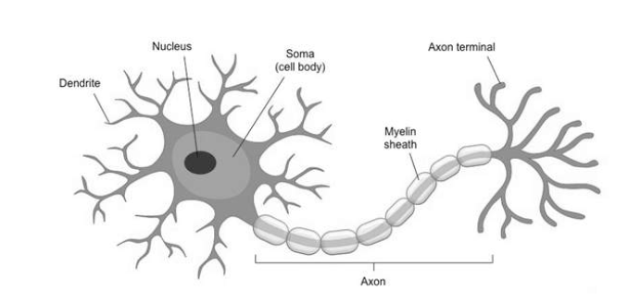

Slide 4
Artificial neurons & Activation functions
An artificial neuron is a mathematical function conceived as a model of biological neurons. Artificial neurons are elementary units in an artificial neural network.
The artificial neuron receives one or more inputs and sums them to produce an output.
Activation function defines how a neuron’s combined input signals are transformed into a single output signal to be broadcasted further in the network.

Slide 5
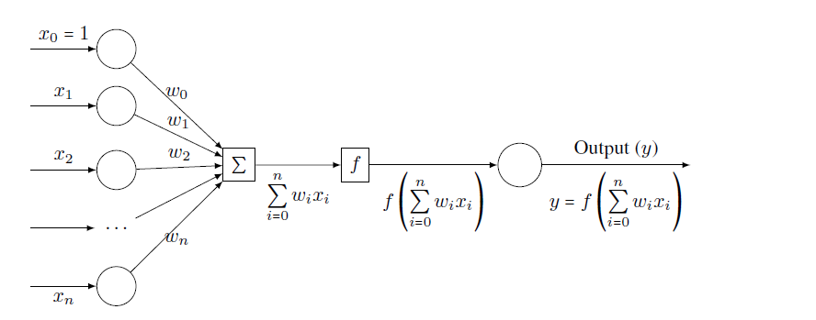
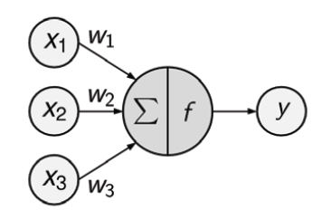
Schematic representation of an artificial neuron

Slide 6
Network topology
The capacity of a neural network to learn is rooted in its topology, or the patterns and structures of interconnected neurons.
They can be differentiated by three key characteristics:
The number of layers
The direction of information travel
The number of nodes within each layer of the network

Slide 7
1. The number of layers
A set of neurons called Input Nodes receive unprocessed signals directly from the input data.
Each input node is responsible for processing a single feature in the dataset; the feature's value will be transformed by the node's activation function.
The signals resulting from the input nodes are received by the Output Node, which uses its own activation function to generate a final prediction (denoted here as p).
The input and output nodes are arranged in groups known as layers.
Because the input nodes process the incoming data exactly as received, the network has only one set of connection weights (labeled here as w1, w2, and w3). It is therefore termed a single-layer network.
Single-layer networks can be used for basic pattern classification, particularly for patterns that are linearly separable.

Slide 8
A multilayer network adds one or more hidden layers that process the signals from the input nodes prior to reaching the output node.
Most multilayer networks are fully connected, which means that every node in one layer is connected to every node in the next layer, but this is not required.

Slide 9
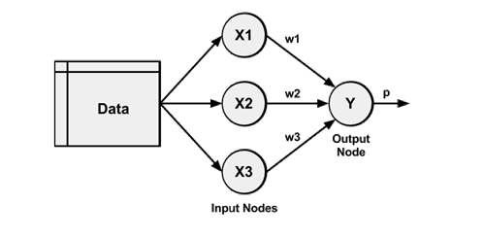
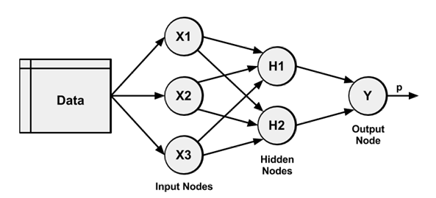
1. single-layer network
2. Multilayer network

Slide 10
2. The direction of information travel
Feed forward networks
Networks in which the input signal is fed continuously in one direction from connection-to-connection until reaching the output layer are called feed forward networks
2. Feedback networks
A recurrent network (or feedback network) allows signals to travel in both directions using loops.
In spite of their potential, recurrent networks are still largely theoretical and are rarely used in practice. On the other hand, feed forward networks have been extensively applied to real-world problems.

Slide 11
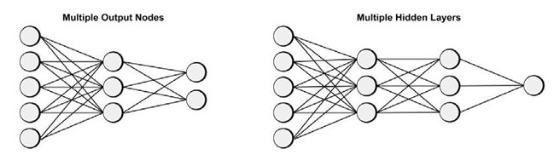
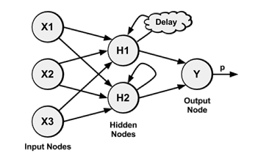
1. Feed forward networks
2. Feedback networks

Slide 12
3. The number of nodes in each layer
The number of input nodes is predetermined by the number of features in the input data.
Similarly, the number of output nodes is predetermined by the number of outcomes to be modeled or the number of class levels in the outcome.
However, the number of hidden nodes is left to the user to decide prior to training the model.
Unfortunately, there is no reliable rule to determine the number of neurons in the hidden layer.
The appropriate number depends on the number of input nodes, the amount of training data, the amount of noisy data, and the complexity of the learning task among many other factors.

Slide 13
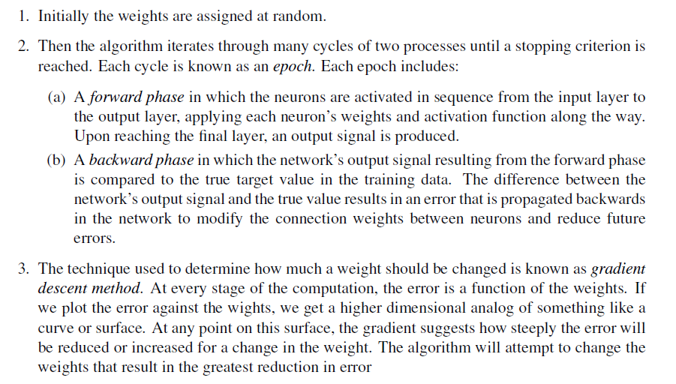
Training neural networks with back propagation
    Outline of the backpropagation algorithm

